Slide 1


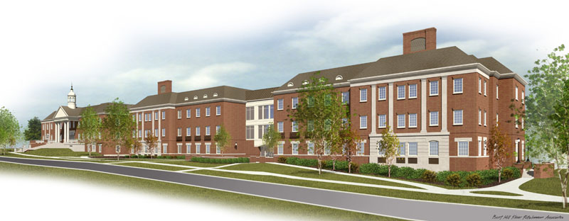
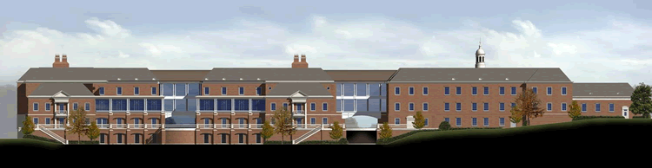

School of Engineering
And Applied Sciences
Building
Jonathan Kirk
Structural Option
Miami University
Oxford, OH

Slide 2

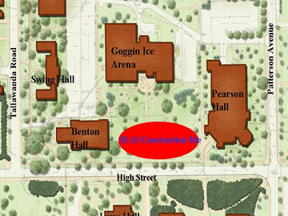
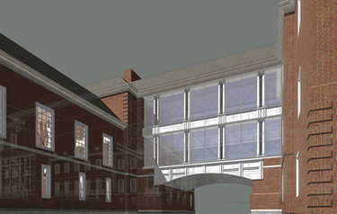
Building Background
Presentation Outline
Connected to existing Benton Hall via skywalk
Size: 103,154 SF above grade on 4 levels
  82,661 SF below grade parking on 3 levels
Cost: $23,651,159
Constructed: Oct. 2004 – Jan. 2007
Delivery Method: Design-Bid-Build
General Contractor: Monarch Construction
Architect: Burt Hill Kosar Rittleman Associates
Structural Engineer: THP Limited
Introduction
  Building Background
  Project Goals
Structural Depth
Building Enclosures Breadth
Construction Management Breadth
Conclusions

Slide 3
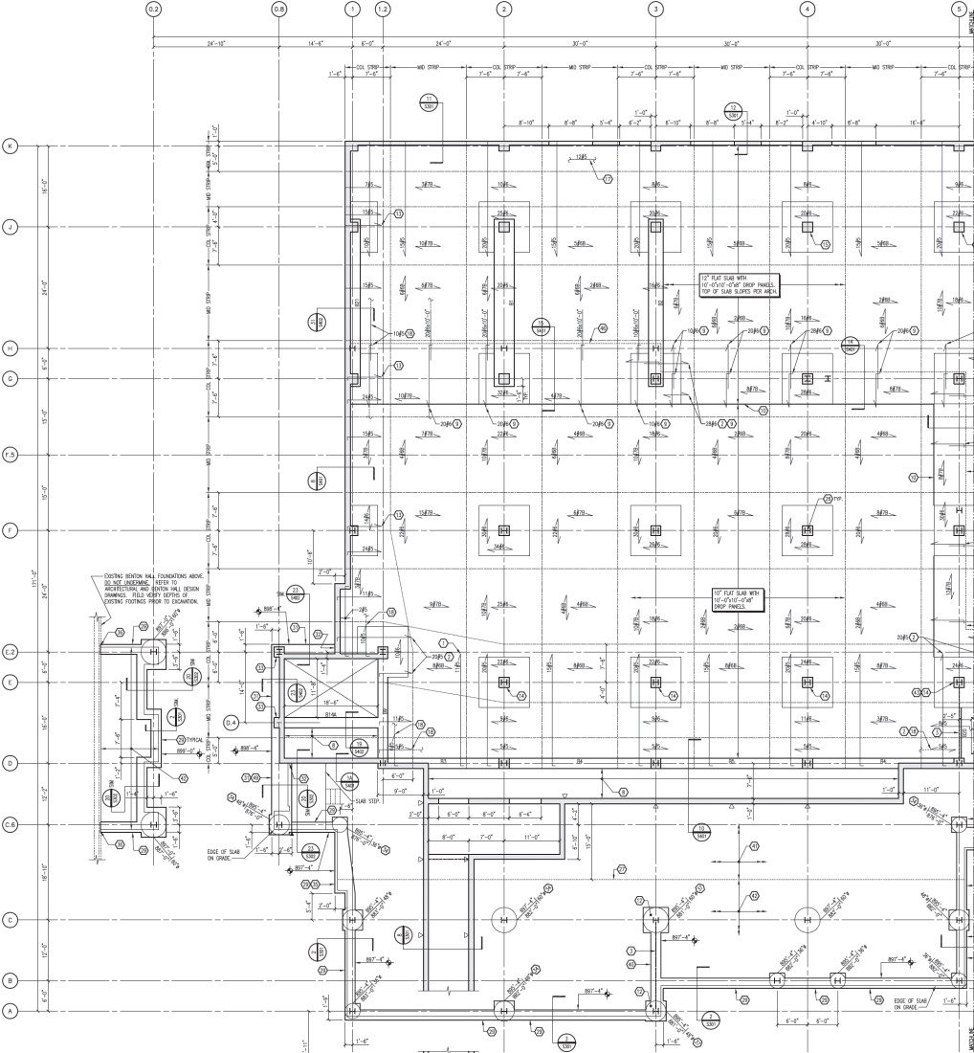
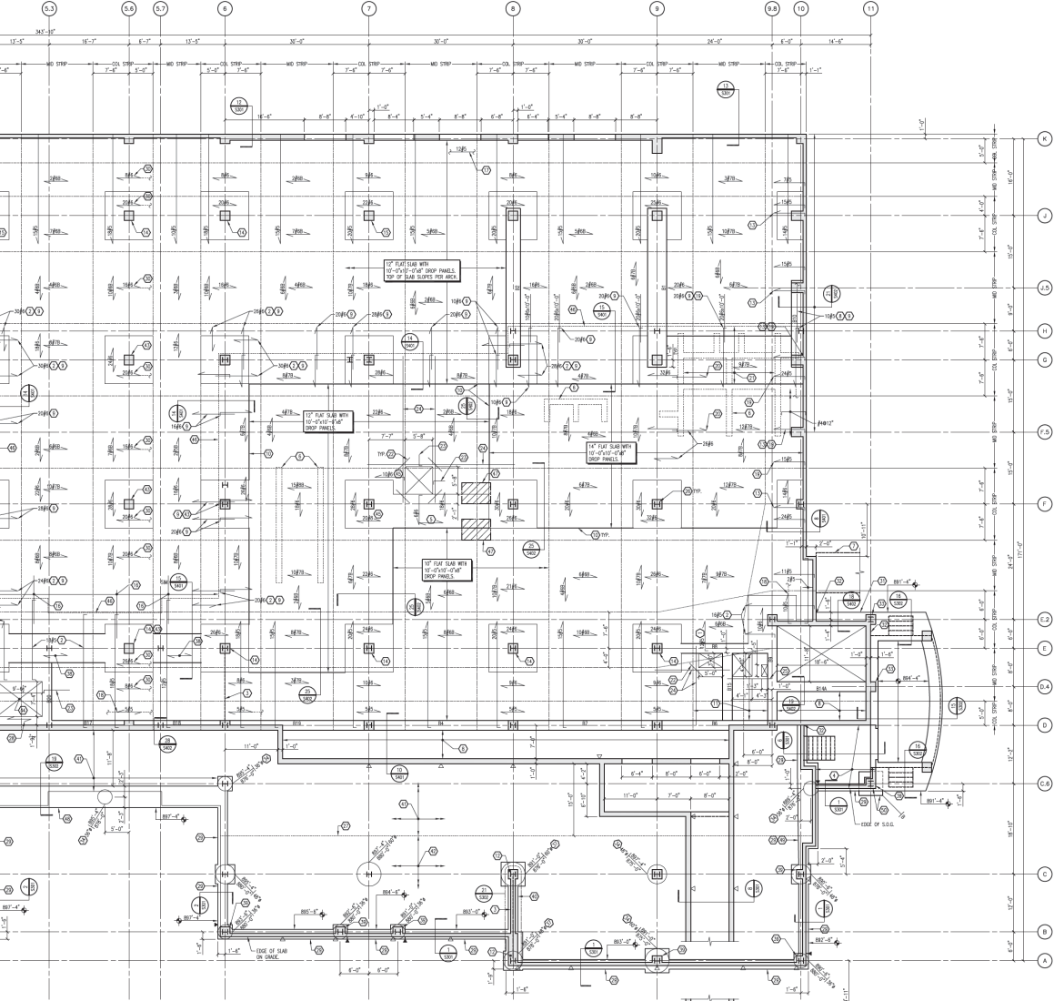
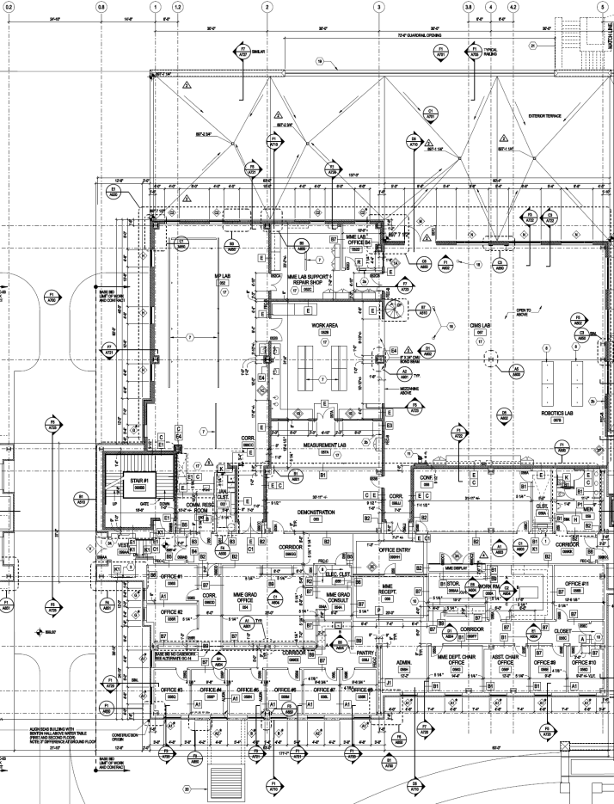
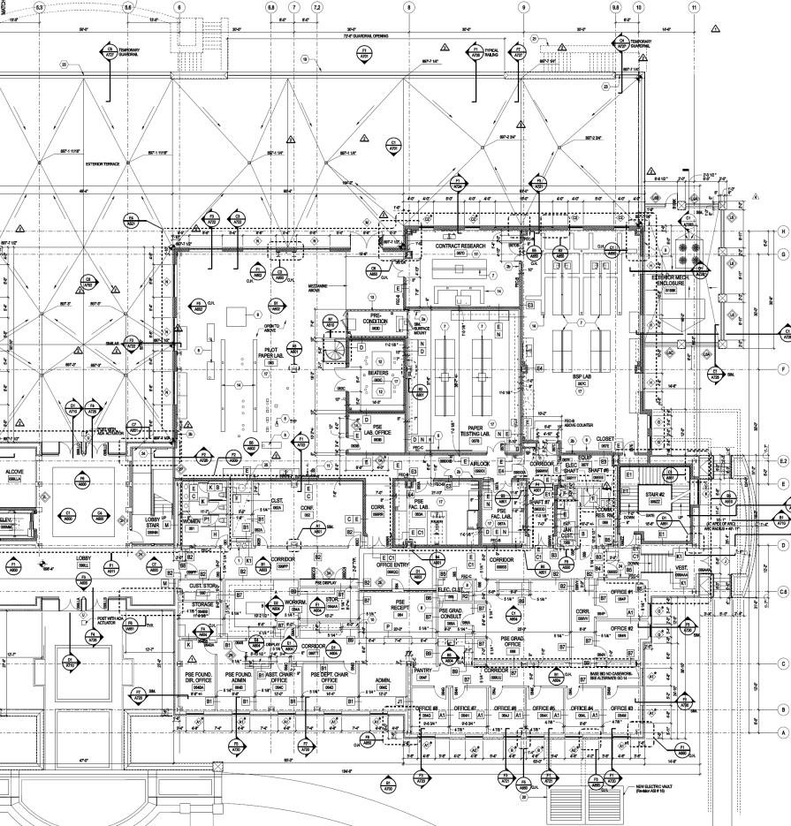
Existing Conditions
Presentation Outline
Ground Floor Framing Plan
Substructure
  Ground Floor and Garage
    2-way C.I.P. slab with drop panels
Introduction
Structural Depth
  Existing Conditions
  Proposed Redesign
Building Enclosures Breadth
Construction Management Breadth
Conclusions

Slide 4
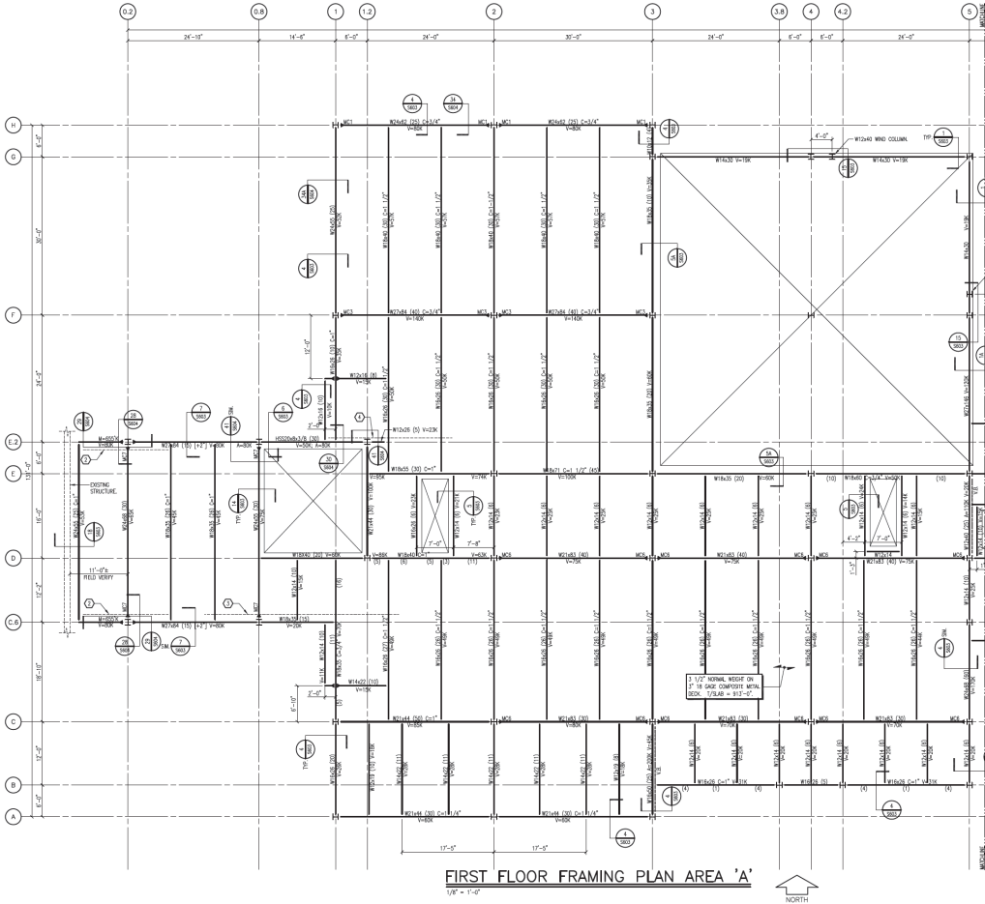
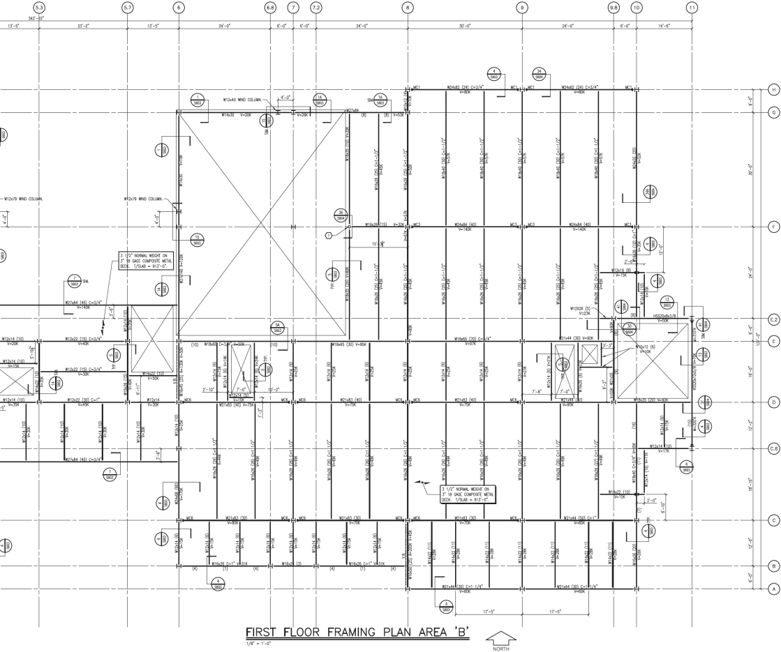
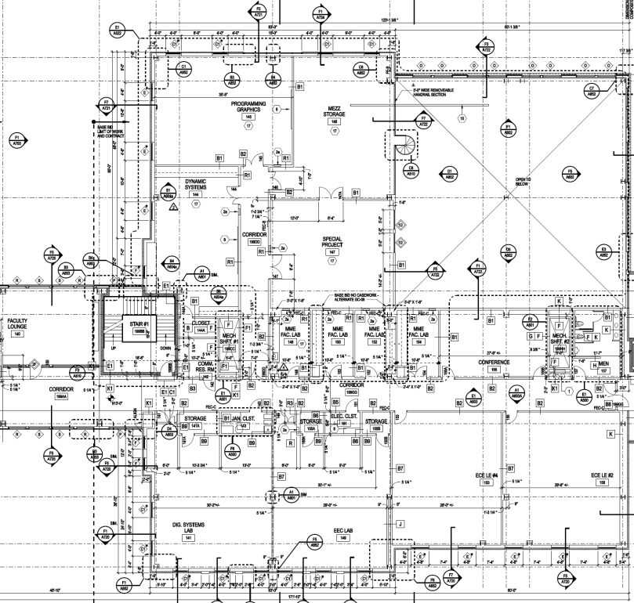
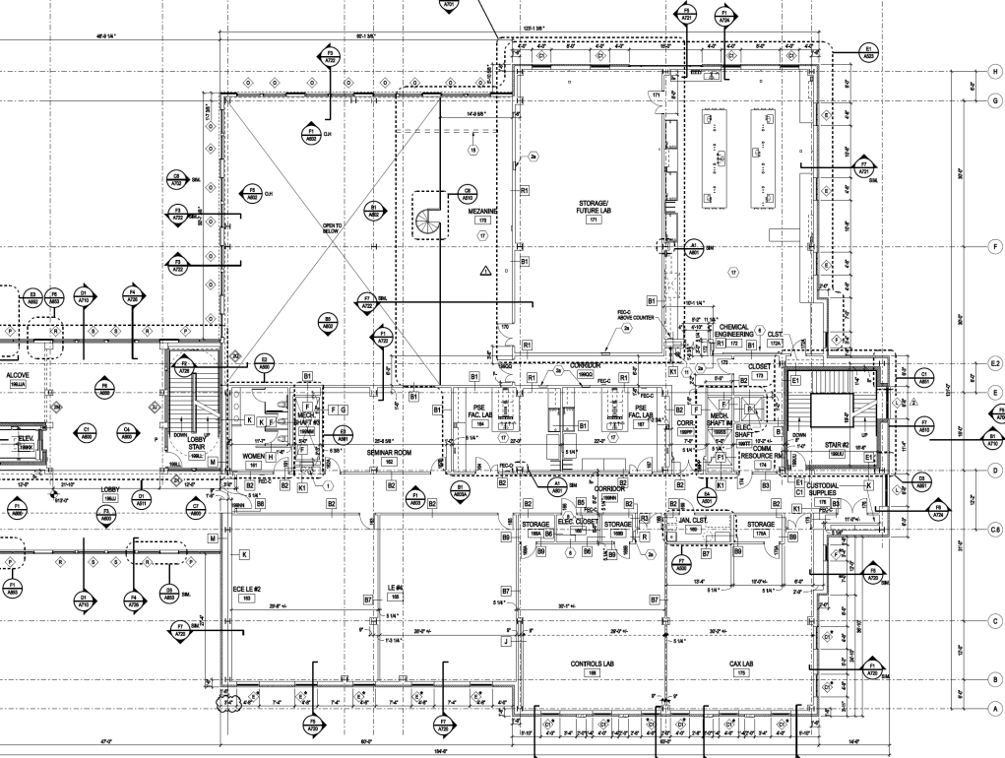
Existing Conditions
Presentation Outline
First Floor Framing Plan
Superstructure
  1st, 2nd, Mechanical, and Roof Levels
    3½” Composite slab on 3” composite deck on steel frame structure
Introduction
Structural Depth
  Existing Conditions
  Proposed Redesign
Building Enclosures Breadth
Construction Management Breadth
Conclusions

Slide 5
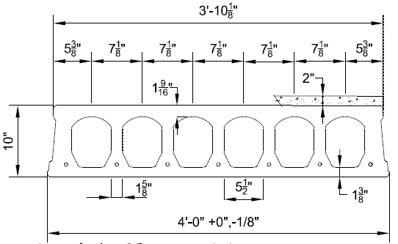
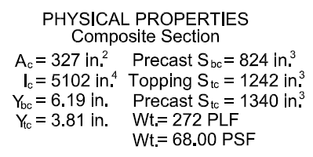
Hollowcore Floor Planks
Proposed Redesign
Presentation Outline
Goals and Design Constraints
  Accelerated construction schedule
  Decrease or maintain cost
  Do not change architecture
  Maintain floor-to-ceiling and total heights
Introduction
Structural Depth
  Existing Conditions
  Proposed Redesign
Building Enclosures Breadth
Construction Management Breadth
Conclusions
Method
  Prefabricated structure
    Precast concrete hollowcore floor planks
    Supported on similar steel frame
10” Hollowcore Plank with 2” Concrete Topping
ECHO by Nitterhouse Concrete Products, Inc.

Slide 6
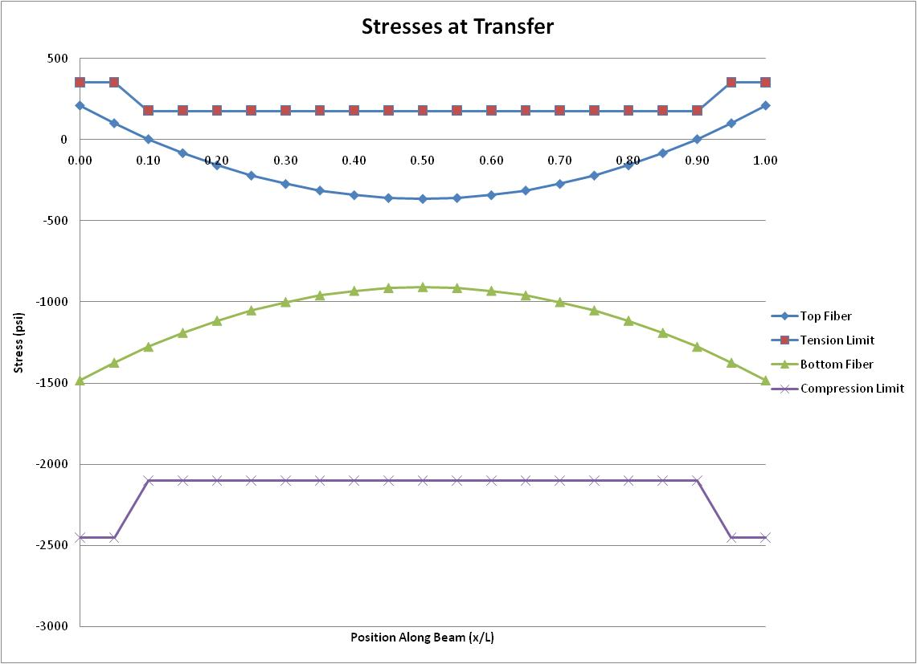
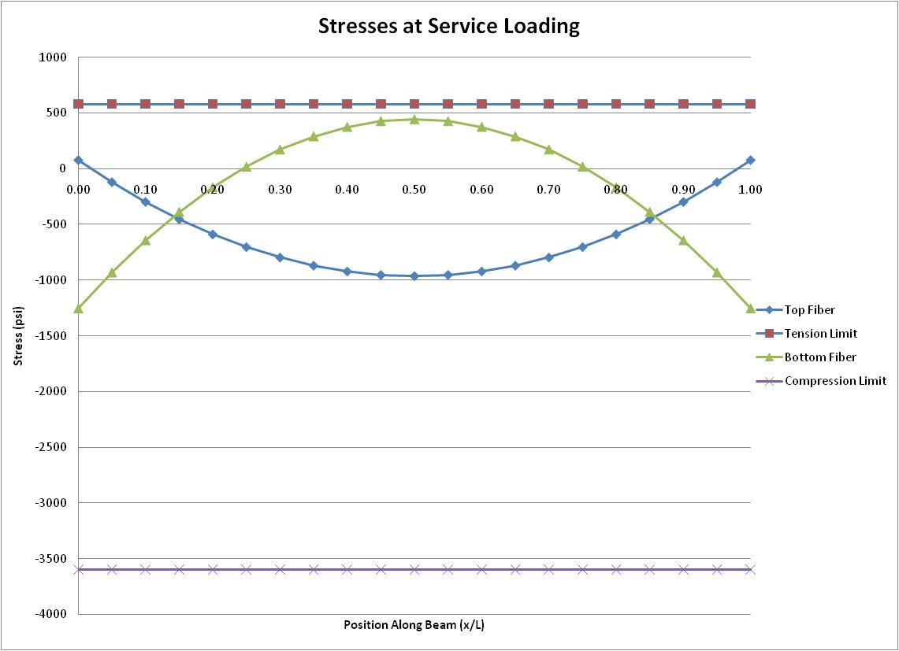
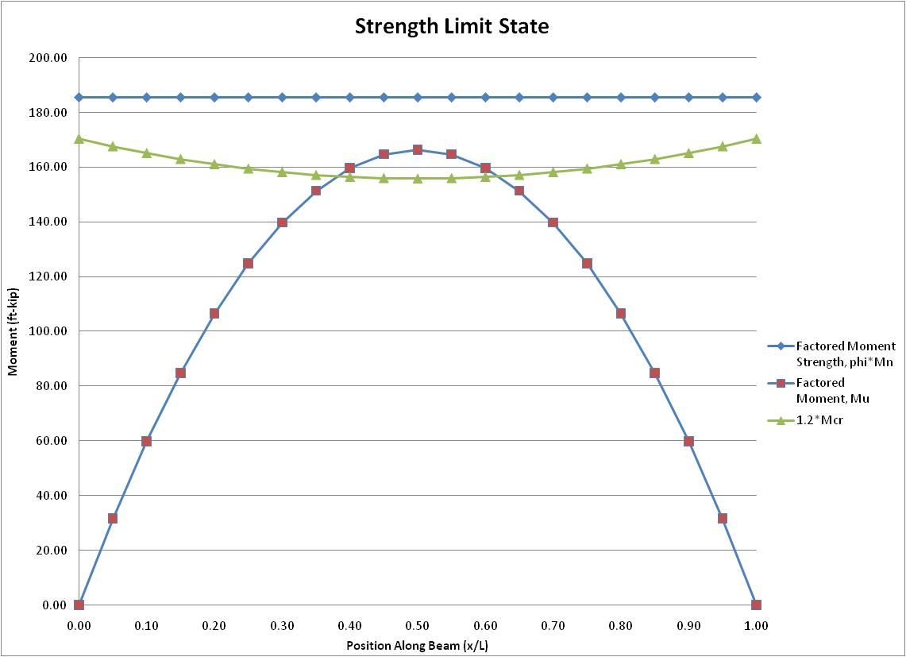
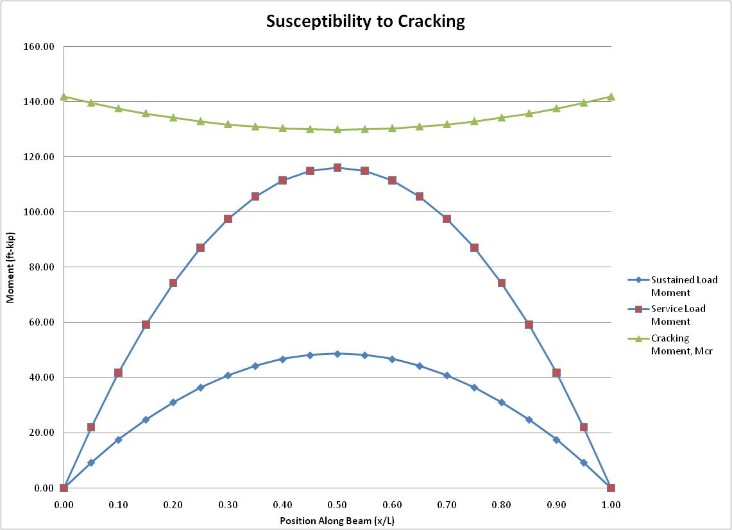
Hollowcore Floor Planks
Hollowcore Floor Planks
Presentation Outline
Introduction
Structural Depth
  Existing Conditions
  Proposed Redesign
Building Enclosures Breadth
Construction Management Breadth
Conclusions
10” Hollowcore Plank with 2” Concrete Topping
ECHO by Nitterhouse Concrete Products, Inc.

Slide 7
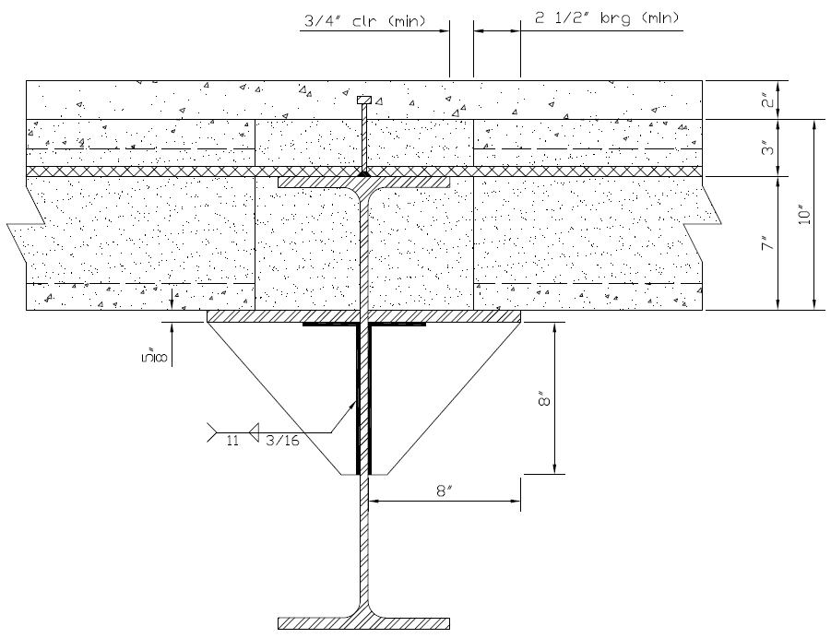
Support System
Hollowcore Floor Planks
Presentation Outline
Introduction
Structural Depth
  Existing Conditions
  Proposed Redesign
Building Enclosures Breadth
Construction Management Breadth
Conclusions

Slide 8
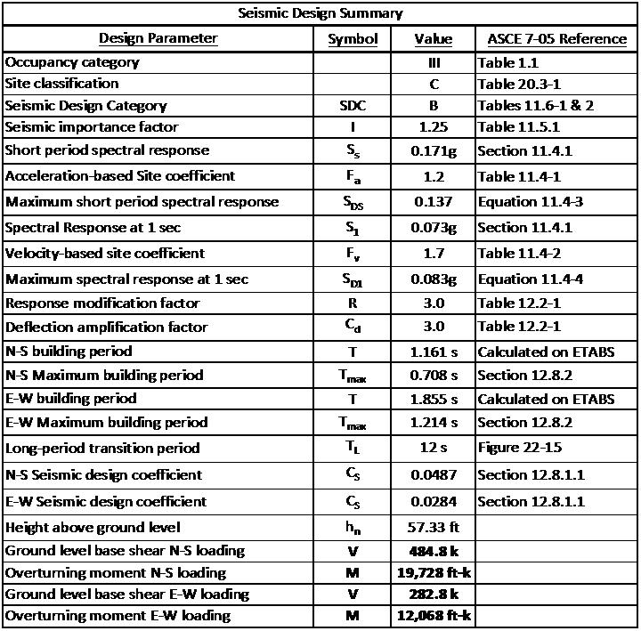
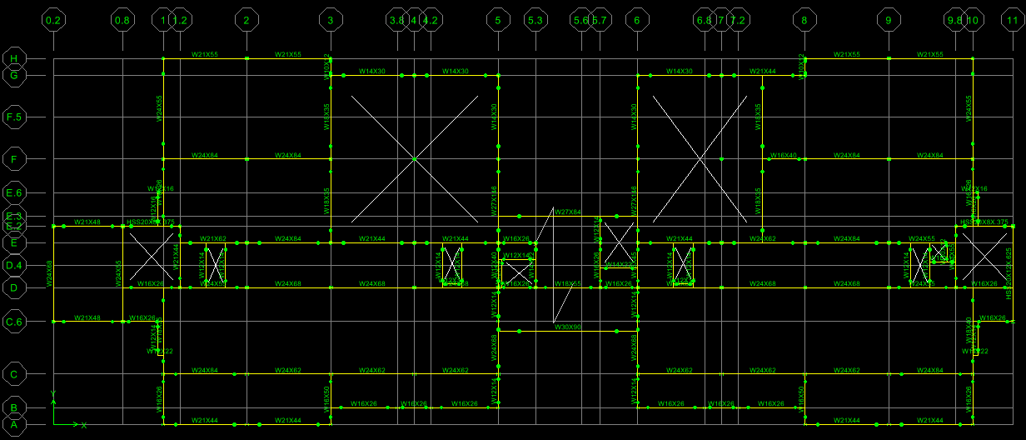
Seismic Loads
Steel Framing
Presentation Outline
Introduction
Structural Depth
  Existing Conditions
  Proposed Redesign
Building Enclosures Breadth
Construction Management Breadth
Conclusions
First Floor Framing Plan

Slide 9
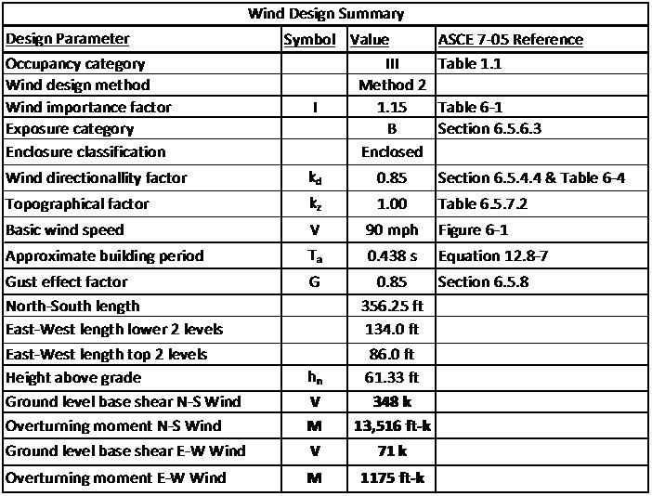
Wind Loads
Steel Framing
Presentation Outline
Introduction
Structural Depth
  Existing Conditions
  Proposed Redesign
Building Enclosures Breadth
Construction Management Breadth
Conclusions
First Floor Framing Plan

Slide 10
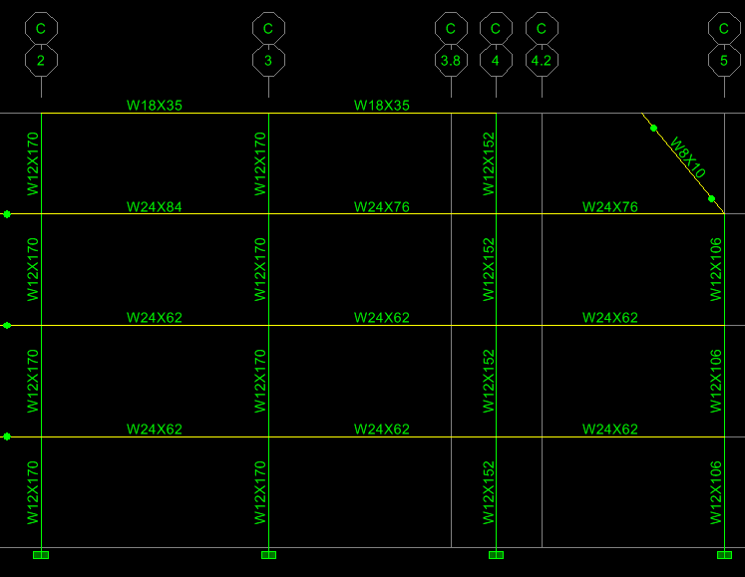
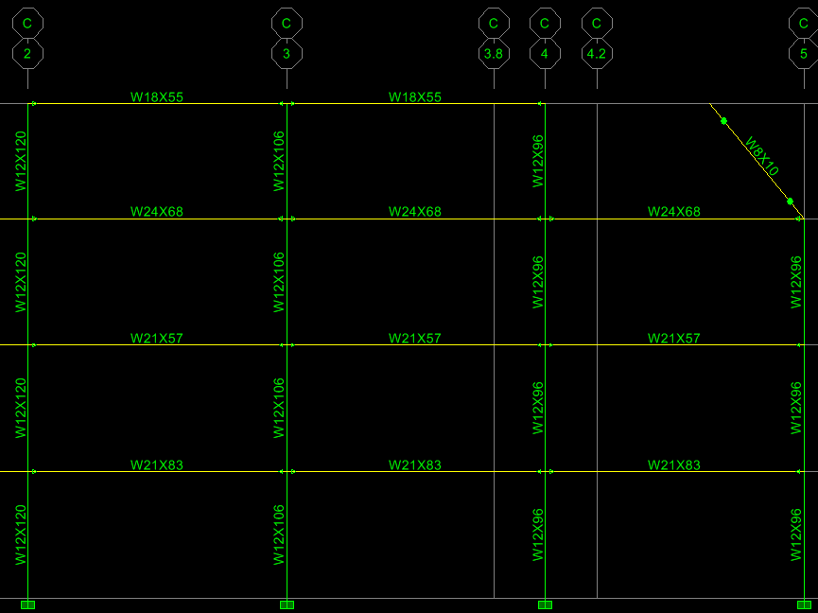
Lateral Resisting System
Steel Framing
Presentation Outline
Introduction
Structural Depth
  Existing Conditions
  Proposed Redesign
Original Frame C
Building Enclosures Breadth
Construction Management Breadth
Conclusions
Resized Frame C
First Floor Framing Plan
Moment Frame

Slide 11
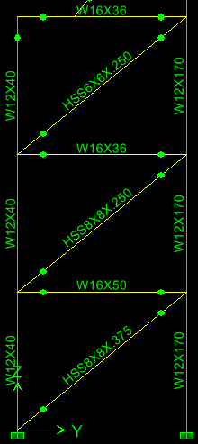
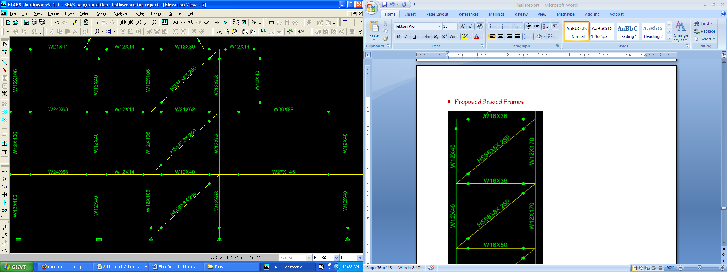
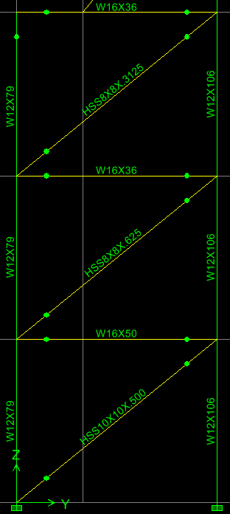
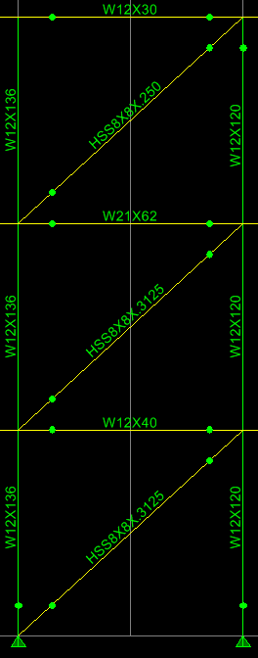
Lateral Resisting System
Steel Framing
Presentation Outline
Introduction
Structural Depth
Original Braced Frames
  Existing Conditions
  Proposed Redesign
Building Enclosures Breadth
Construction Management Breadth
Conclusions
First Floor Framing Plan
Moment Frame
Braced Frame
Resized Braced Frames

Slide 12
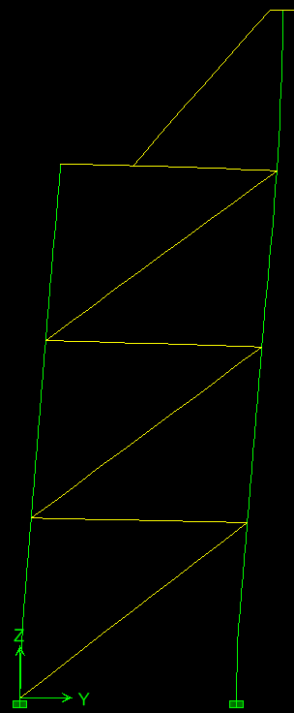
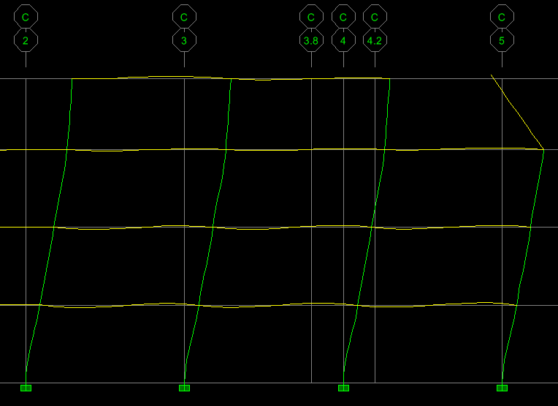
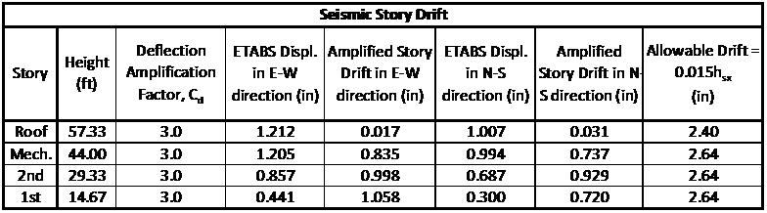
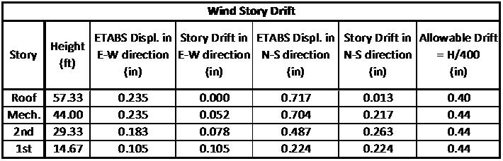
Lateral Displacement
Story Drifts
Presentation Outline
Introduction
Structural Depth
  Existing Conditions
  Proposed Redesign
Building Enclosures Breadth
Construction Management Breadth
Conclusions
Moment Frame C Deflection Under Seismic Loading
Braced Frame 3 Deflection Under Seismic Loading

Slide 13
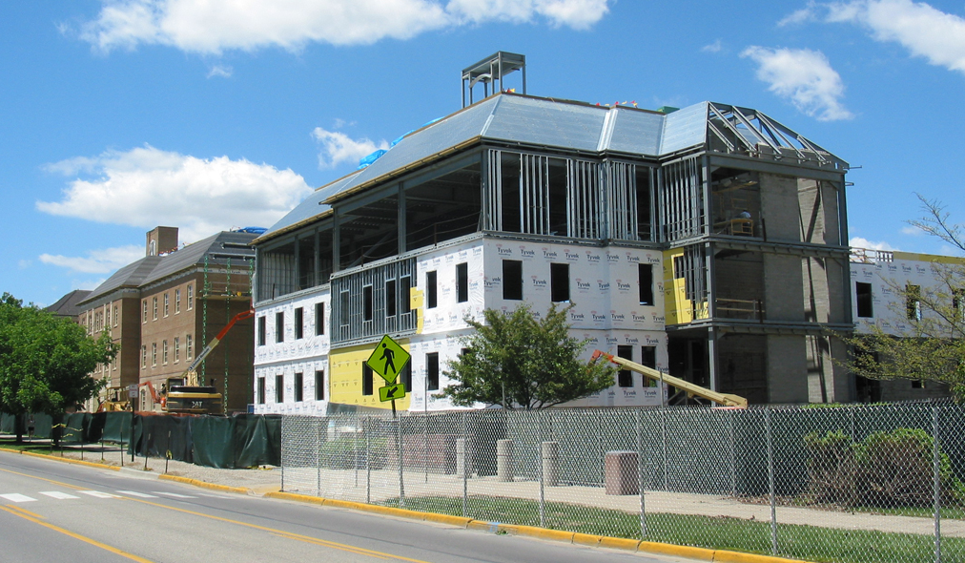
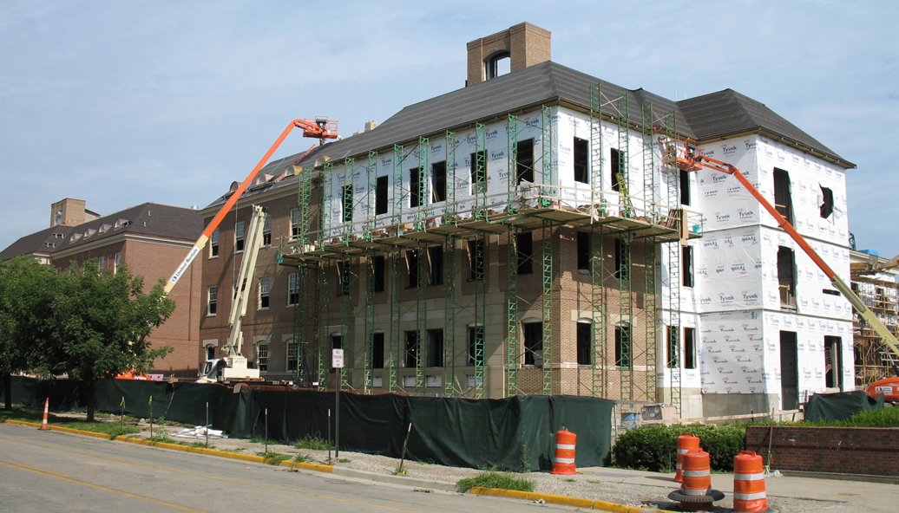
Existing Walls
Existing Walls
Presentation Outline
Introduction
Structural Depth
Building Enclosures Breadth
  Existing Conditions
  Proposed Redesign
Construction Management Breadth
Conclusions
Typical Wall Section

Slide 14
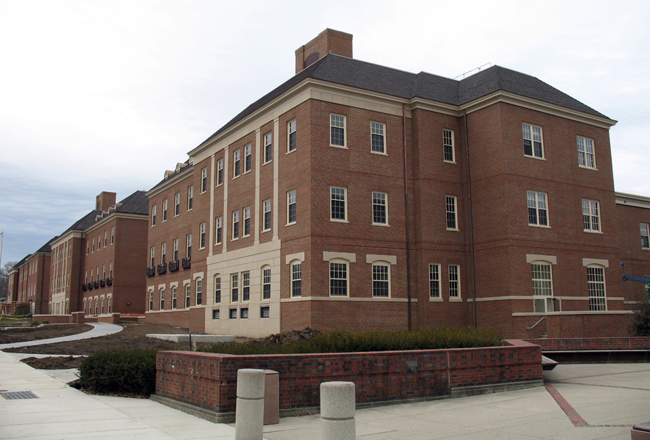
Proposed Redesign
Presentation Outline
Goals
  Accelerated construction schedule
  Decrease or maintain cost
  Minimize architectural effects
  Retain thermal properties
Introduction
Structural Depth
Building Enclosures Breadth
  Existing Conditions
  Proposed Redesign
Method
  Prefabricated wall panels
    Precast concrete insulated sandwich panels
Construction Management Breadth
Conclusions

Slide 15
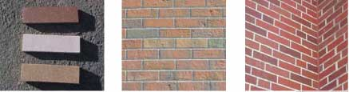
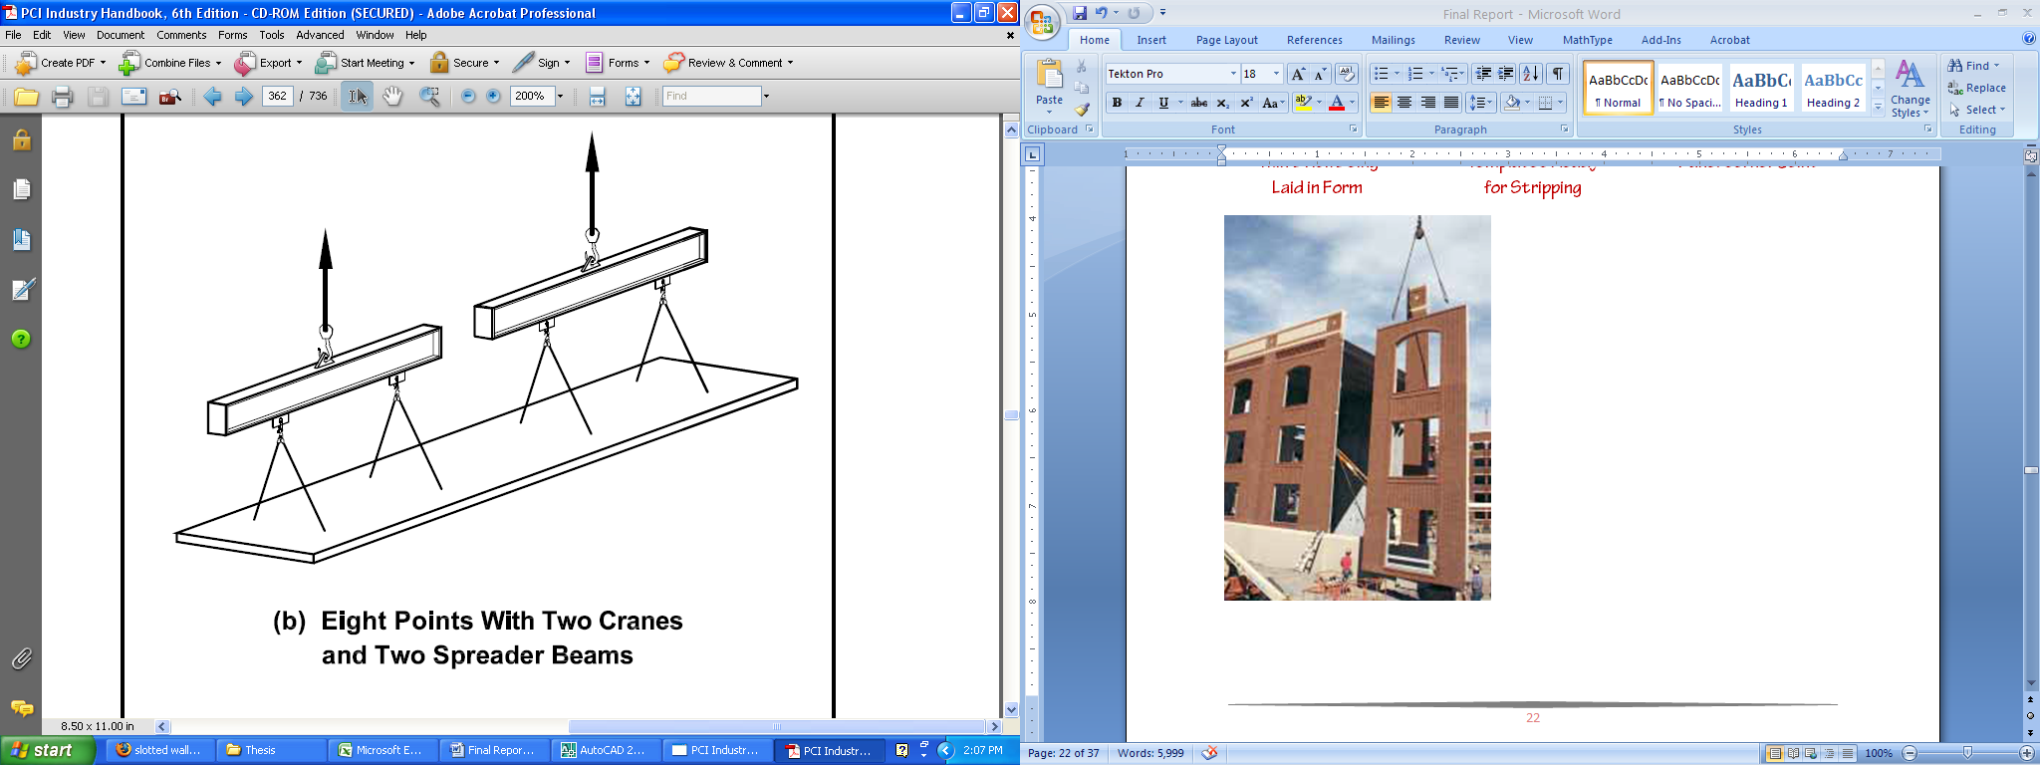
Proposed Wall Panels
Typical Sandwich Wall Panel
Presentation Outline
Introduction
Structural Depth
Building Enclosures Breadth
  Existing Conditions
  Proposed Redesign
Thin Brick provides look of traditional brick veneer
Construction Management Breadth
Conclusions
Panel Stripping Configuration
Panel Erection
Typical 12’ Wall Panel
Panel Cross Section

Slide 16
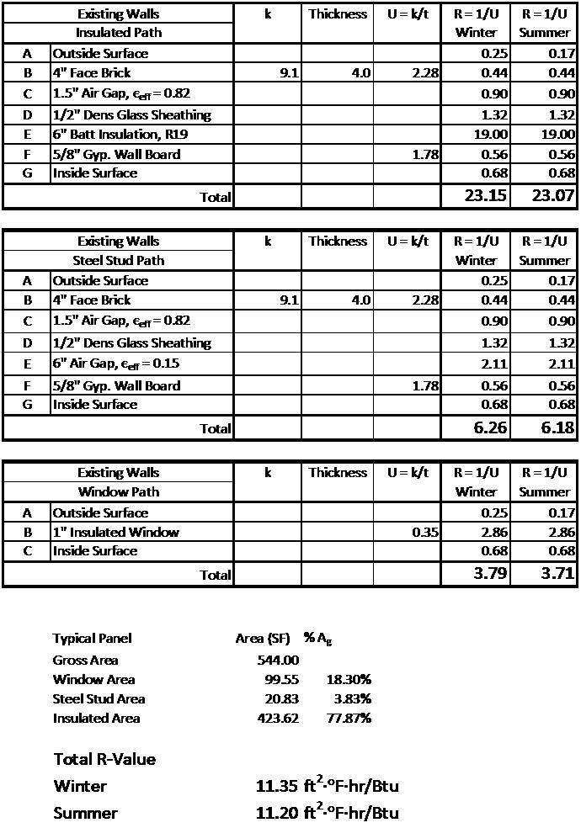
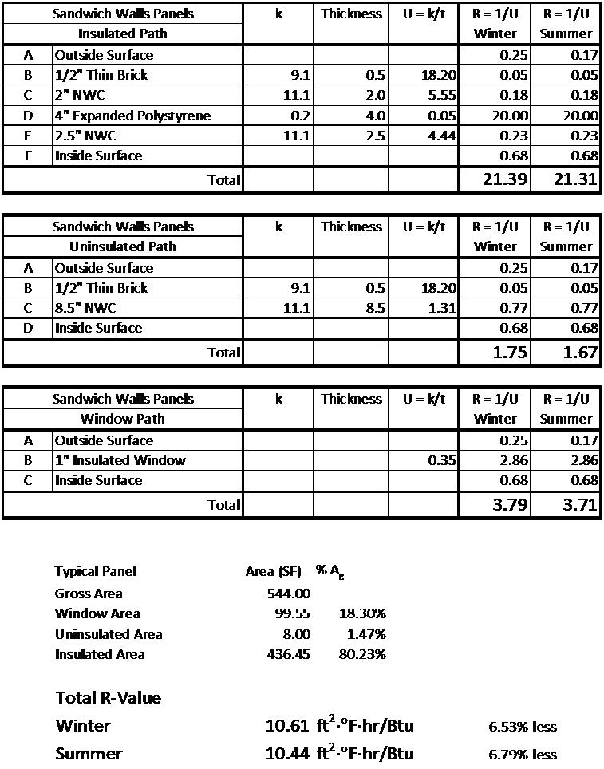
Thermal Resistance
Typical Sandwich Wall Panel
Presentation Outline
Introduction
Structural Depth
Building Enclosures Breadth
  Existing Conditions
  Proposed Redesign
Construction Management Breadth
Conclusions
Existing Wall R-Values
Proposed Wall R-Values
Typical 12’ Wall Panel
Panel Cross Section

Slide 17
Existing Structure Cost
Proposed Structure Cost
Presentation Outline
Introduction
Structural Depth
Building Enclosures Breadth
Construction Management Breadth
  Cost Comparison
  Schedule Comparison
Conclusions
Additional Cost = $218,650 = 14.4% Increase
If hollowcore is supported by top flange of girder, eliminates approximately $1.83/SF, for a new total cost of $1,572,228, only a $57,065 increase (3.8%)

Slide 18
Existing Walls Cost
Proposed Wall Panel Cost
Presentation Outline
Introduction
Structural Depth
Building Enclosures Breadth
Construction Management Breadth
Cost of panel quoted by Nitterhouse Concrete Products, Inc. to be $29.00/SF including overhead and profit, which was approximated to be 30%
  Cost Comparison
  Schedule Comparison
Labor cost calculated by the rate of a steel erection crew (C-11) erecting 12 panels/day
Conclusions
Additional Cost = $212,017 = 36.7% Increase

Slide 19
Existing Systems Schedule
Proposed Systems Schedule
Presentation Outline
Introduction
Structural Depth
Building Enclosures Breadth
Construction Management Breadth
  Cost Comparison
  Schedule Comparison
Conclusions
Approximately 5 weeks saved from critical path
Subcontractors in the building interior sooner
Increased flexibility from addition of float time

Slide 20
Further Considerations
Presentation Outline
Project circumstances and local practices
Impact on garage structure and foundations
Increase structural sandwich to eliminate hollowcore supporting plates
Fabrication lead times
Full vibration and acoustical analysis of hollowcore planks
Transfer beam on northern wall for wall panels
Change of substructure to precast concrete
Introduction
Structural Depth
Building Enclosures Breadth
Construction Management Breadth
Conclusions
  Further Considerations
  Final Recommendations
  Acknowledgements
  Questions

Slide 21
Further Considerations
Final Recommendations
Presentation Outline
Project circumstances and local practices
Impact on garage structure and foundations
Increase structural sandwich to eliminate hollowcore supporting plates
Fabrication lead times
Full vibration and acoustical analysis of hollowcore planks
Transfer beam on northern wall for wall panels
Change of substructure to precast concrete
All goals met except cost control
Current structural and wall systems best for the project
  No time constraints so accelerated schedule not a necessity
  No direct advantage to justify increased cost
Introduction
Structural Depth
Building Enclosures Breadth
Construction Management Breadth
Conclusions
  Further Considerations
  Final Recommendations
  Acknowledgements
  Questions

Slide 22
Acknowledgements
Final Recommendations
Presentation Outline
My parents – Victoria and Edward Kirk
Miami University of Ohio
Steve Nearhoof and Alex Wing – Burt Hill
John Jones, Bart Staley, Mike Thomas, Cliff Miles – Nitterhouse Concrete Products, Inc.
Dr. Andres Lepage, Dr. John Messner – PSU AE
Industry professionals
Fellow students
All goals met except cost control
Current structural and wall systems best for the project
  No time constraints so accelerated schedule not a necessity
  No direct advantage to justify increased cost
Introduction
Structural Depth
Building Enclosures Breadth
Construction Management Breadth
Conclusions
  Further Considerations
  Final Recommendations
  Acknowledgements
  Questions

Slide 23
Acknowledgements
Presentation Outline
My parents – Victoria and Edward Kirk
Miami University of Ohio
Steve Nearhoof and Alex Wing – Burt Hill
John Jones, Bart Staley, Mike Thomas, Cliff Miles – Nitterhouse Concrete Products, Inc.
Dr. Andres Lepage, Dr. John Messner – PSU AE
Industry professionals
Fellow students
Introduction
Structural Depth
Building Enclosures Breadth
Construction Management Breadth
Conclusions
Questions & Answers
  Further Considerations
  Final Recommendations
  Acknowledgements
  Questions

Slide 24
Wall Panel Connections
Typical Sandwich Wall Panel
Presentation Outline
Introduction
Structural Depth
Building Enclosures Breadth
  Existing Conditions
  Proposed Redesign
Construction Management Breadth
Conclusions
PSA Slotted Insert by JVI
4-Way Adjustment Connection at Column
Typical 12’ Wall Panel
Panel Cross Section

Slide 25
Gravity Loads
Proposed Redesign
Presentation Outline
Dead Loads
Goals and Design Constraints
  Accelerated construction schedule
  Decrease or maintain cost
  Do not change architecture
  Maintain floor-to-ceiling and total heights
Introduction
Structural Depth
  Existing Conditions
  Proposed Redesign
Building Enclosures Breadth
Construction Management Breadth
Conclusions
Method
  Prefabricated structure
    Precast concrete hollowcore floor planks
    Supported on similar steel frame
Live Loads

Slide 26
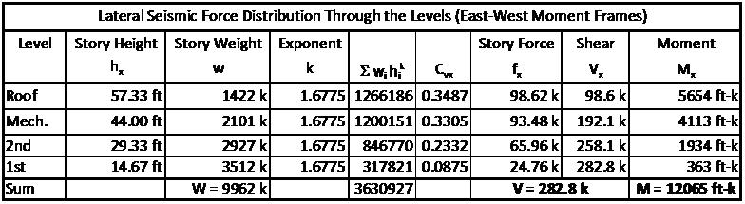
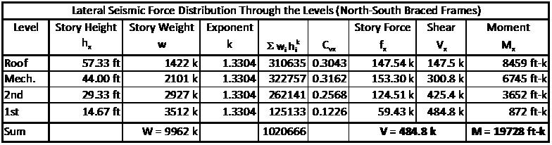
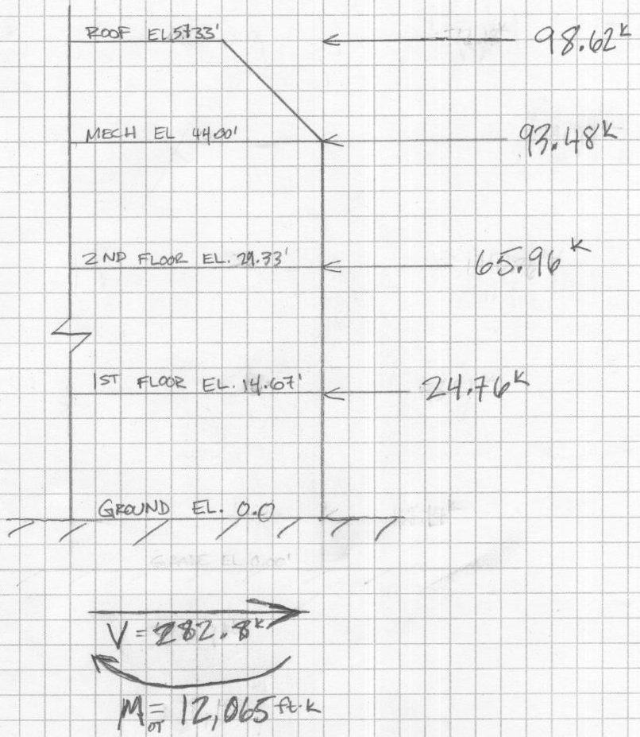
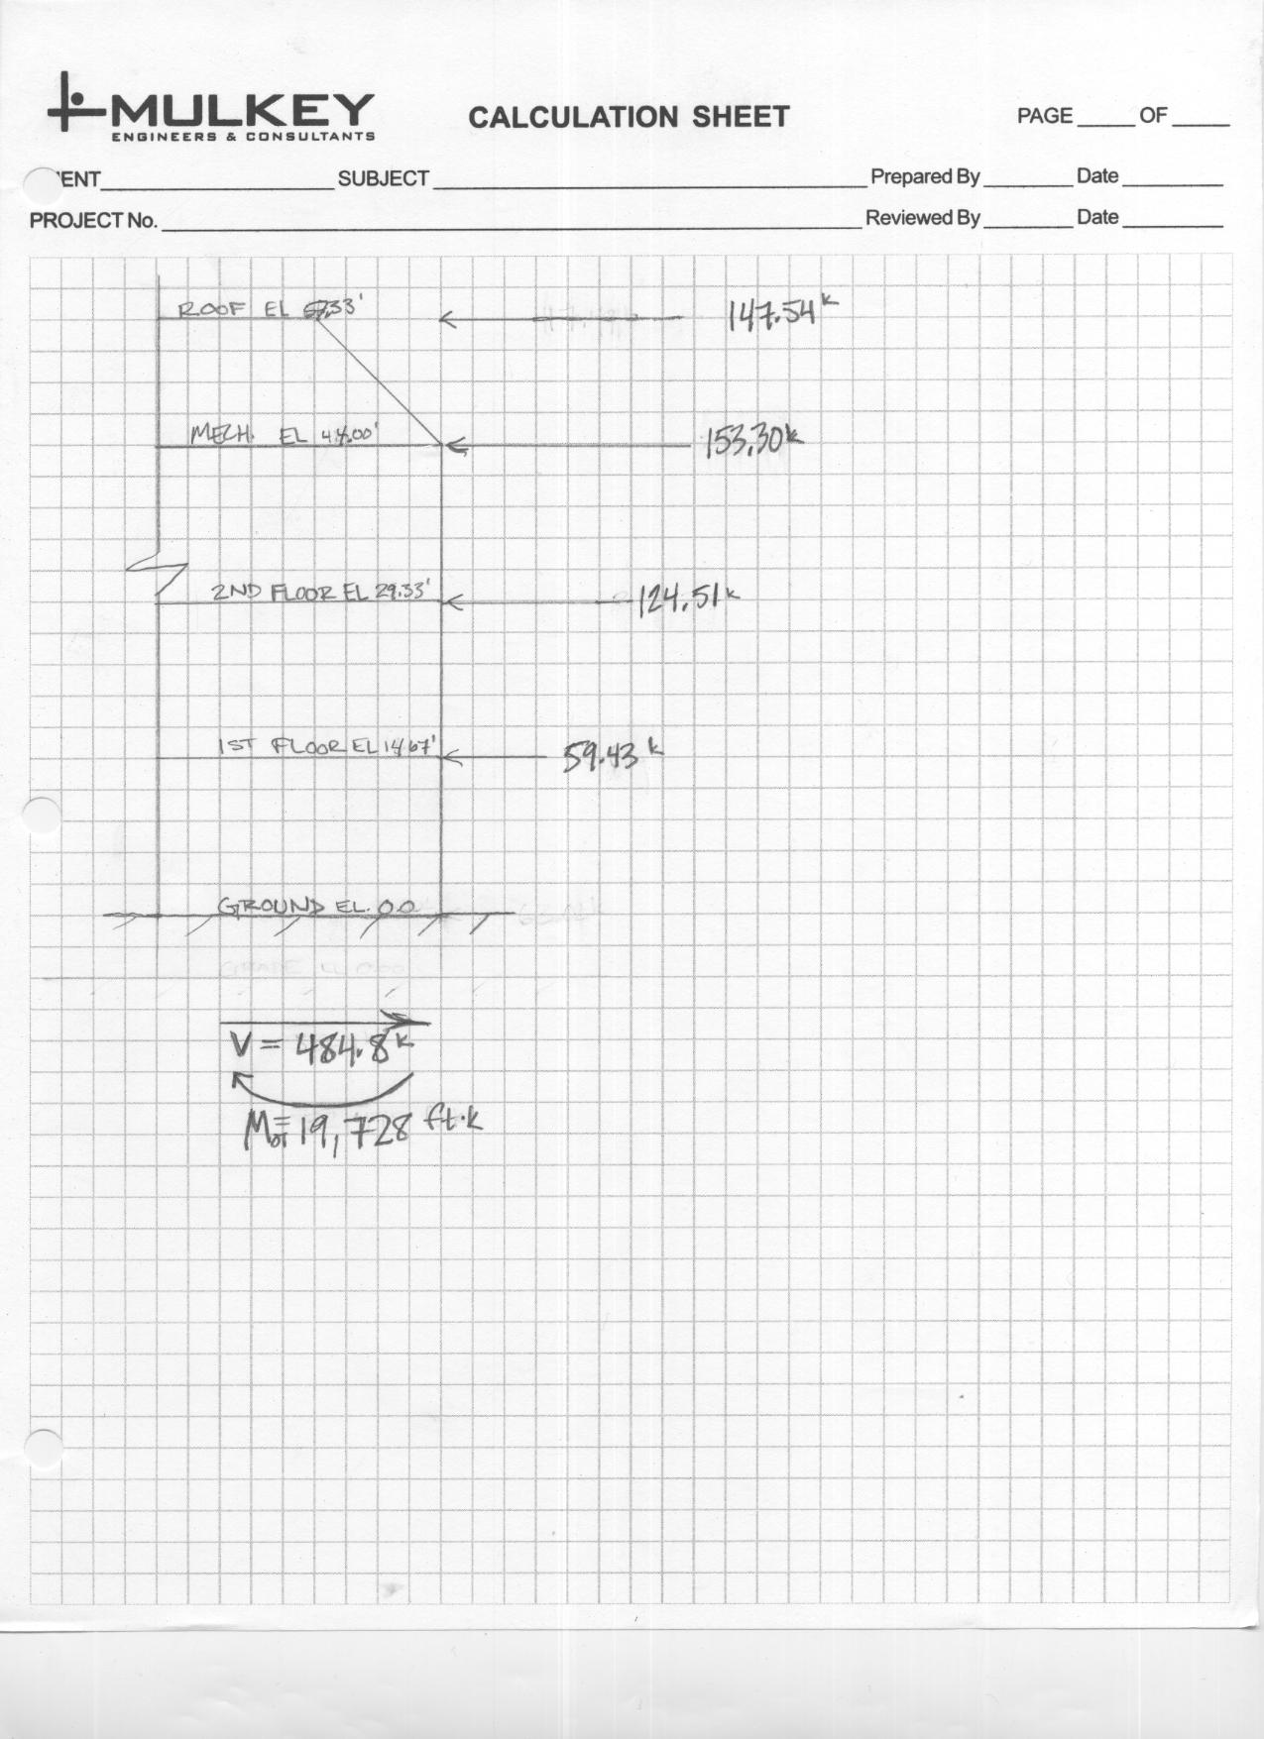
Seismic Loads
Steel Framing
Presentation Outline
Introduction
Structural Depth
  Existing Conditions
  Proposed Redesign
E-W Moment Frame Distribution
N-S Braced Frame Distribution
Building Enclosures Breadth
Construction Management Breadth
Conclusions
First Floor Framing Plan

